Slide 1

Poverty and Crime in Chicago Neighborhoods
Emrah Selli, Petra Lee, Abdullah Sher,, Rick Clauss, Hadijat Makinde,

Slide 2
Background
The 2017 crime rate in Chicago, IL is 508 (City-Data.com crime index), which is 1.8 times greather than the U.S. average.
It was higher than in 95.3% U.S. cities. The 2017 Chicago crime rate is about the same compared to 2016. The number of homicides stood at 653 - a decrease of 112 compared to 2016
The Chicago metro area saw its poverty rate drop to 12.4 percent in 2016 from 13.3 percent the year before, according to American Community Survey data released Thursday by the U.S. Census Bureau.
Meanwhile, median household income increased 3.2 percent in the Chicago metro area, to $66,020.

Slide 3
Rich Blocks, Poor Blocks
In the city of Chicago, tracts with high median incomes include tract 8331 in the West Loop : $98,677 tract 715 in Lincoln Park : $75,122
The poorest census tract in Chicago Armour Square, on the city's South Side.
Tract 3504 : $10,152. Austin, on the city's Far West Side,: with more than 34 homicides in 2012 and 29 homicides in 2011has a median household income of $18,818, compared with a statewide median income range of $48,000 to $59,000. By comparison, the suburb of Oak Park, just a few miles from Austin, recorded 1 homicide in 2011; census tract 8125, in northern Oak Park, has a median income of $65,313. One of the poorest census tracts in Chicago — 2809, on the city's Near West Side, with a median income of $10,217 — isn't far from tract 8331, also on the Near West Side, with a median income of $98,677.

Slide 4
Project
We collected socioeconomic parameters such as unemployment rates, salary rates etc. and compare them with crime rates.
We scraped the data from Chicago Police Department Website and Chicago Data Portal using python, then cleaned, merged and load the data into an SQL database.
We created a multilayer geo-map that will toggle between unemployment, poverty rates and crime statistics for the city of Chicago.
We created interactive plotly bar and bubble charts.
We utilized Python API, HTML/CSS, JavaScript, postgres-SQL, GoogleMaps.

Slide 5
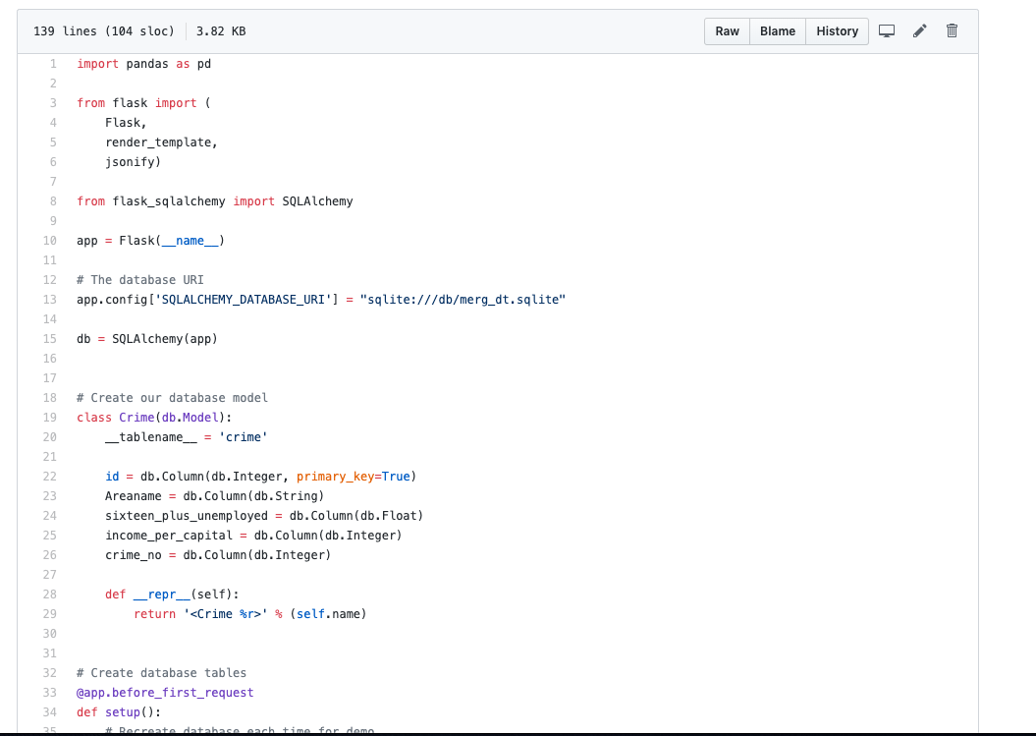
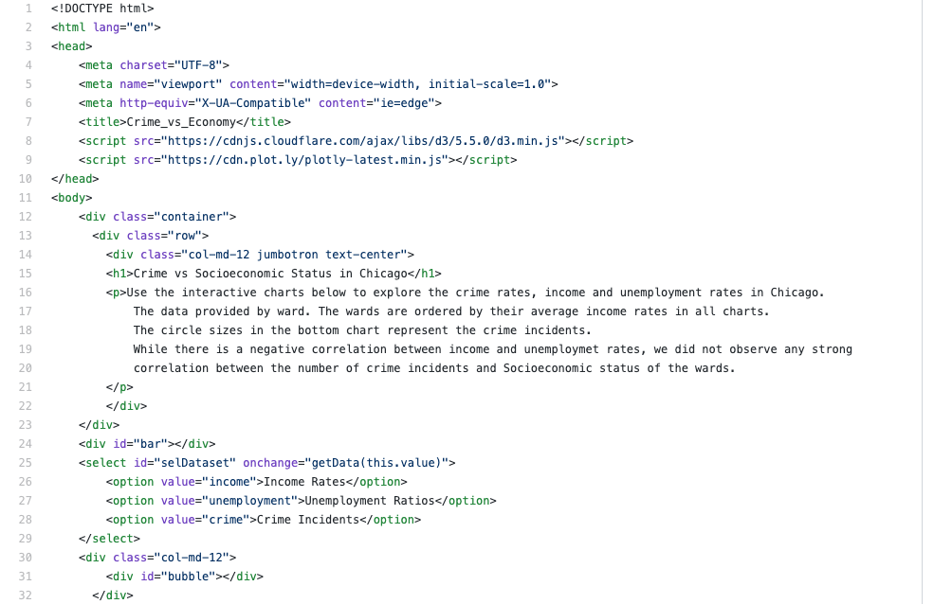
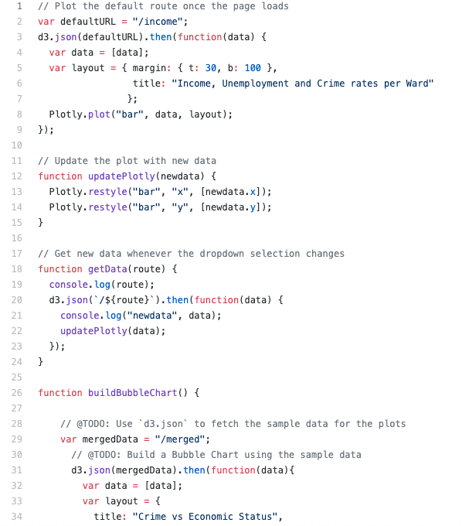
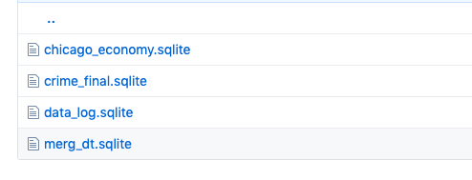
Apps and codes
Flask app
HTML
database
javascript

Slide 6
Dashboard
https://crime-busters.herokuapp.com/

Slide 7
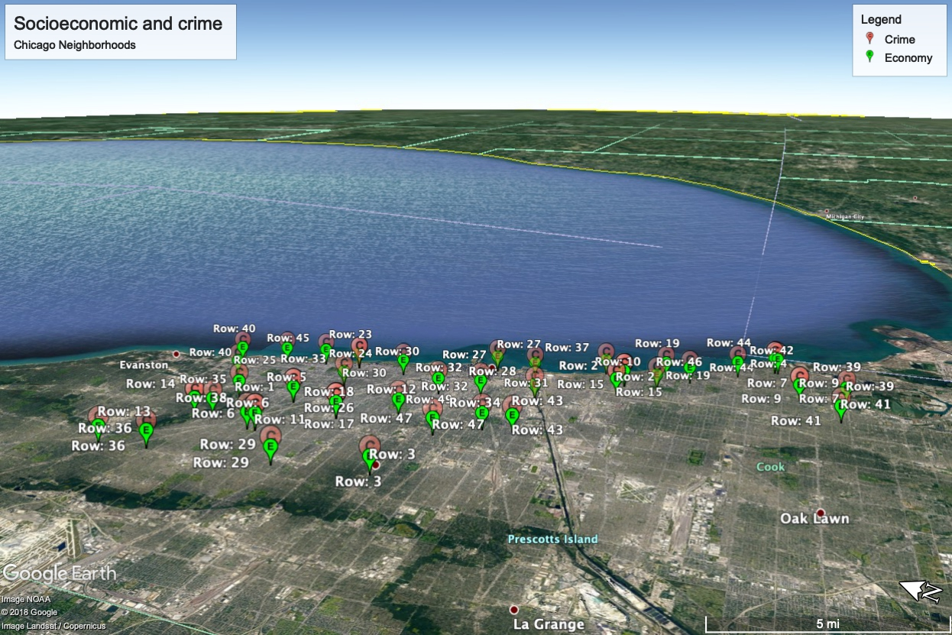
Crime and unemployment Geomap
https://earth.app.goo.gl/QhXc4c

Slide 8



Acknowledgements
The Crime Busters
Emrah Selli
Petra Lee
Abdullah Sher
Rick Clauss
Hadijat Makinde
QUESTIONS?
https://data.cityofchicago.org

